Slide 1
Devops using Redhat Enterprise Openshift
Openshift – Cloud Application Platform
A presentation from Java and Open source competency

Slide 2
Introduction
OpenShift is a cloud computing platform as a service product from Red Hat.
The free and open source cloud-based platform allows developers to create, test and run their applications and deploy them to the cloud.
OpenShift uses Red Hat Enterprise Linux (RHEL) and its SELinux(Security-Enhanced Linux) subsystem as its foundation. OpenShift supports multiple languages for ease of development.
Why Openshift?
OpenShift provides developers and IT organizations with an auto-scaling, cloud application platform for deploying new applications on secure, scalable resources with minimal configuration and management overhead.
OpenShift Enterprise brings the OpenShift PaaS platform to customer data centers, enabling organizations to implement a private PaaS that meets security, privacy, compliance, and governance requirements.

Slide 3
Features of Openshift
Ease of administration:- With OpenShift Enterprise, system administrators no longer have to create development, testing, and production environments. Developers can create their own application stacks using the OpenShift Enterprise Management Console, client tools, or the REST API.
Choice:-Developers can choose their tools, languages, frameworks, and services.
Automatic scaling:- With OpenShift Enterprise, applications can scale out as necessary, adjusting resources based on demand.
Avoid lock-in:- Using standard languages and middleware runtimes means that customers are not tied to OpenShift Enterprise, and can easily move to another platform.
Multiple clouds:- OpenShift Enterprise can be deployed on physical hardware, private clouds, public clouds, hybrid clouds, or a mixture of these, allowing full control over where applications are run.

Slide 4
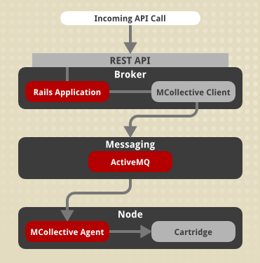
Openshift Architecture
Communication from external clients, such as the client tools or the Management Console, occurs through the REST API that is hosted by the broker.
The broker then communicates to the nodes using the messaging service component.
MCollective queries a set of nodes and communicates securely with individual nodes.
An OpenShift Enterprise deployment consists of two logical types of hosts: a broker and one or more nodes.
The broker handles the creation and management of user applications, the user authentication service, and manages communication with the appropriate nodes.
The nodes run the user applications in contained environments called gears.

Slide 5
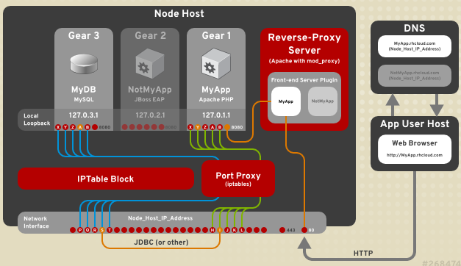
Openshift Node Architecture

Slide 6
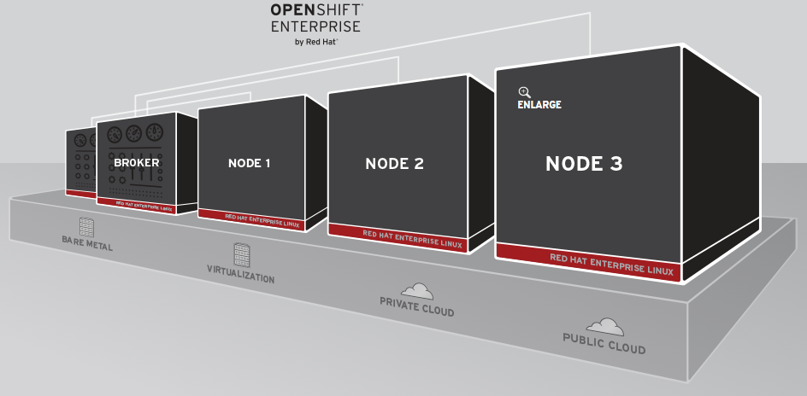
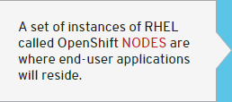
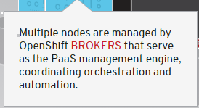
How Openshift Works

Slide 7
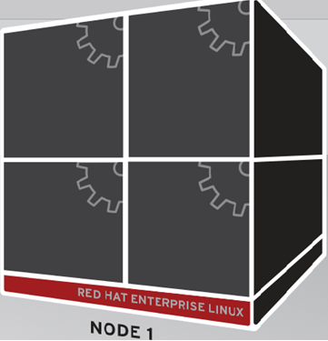

Workflow Of Openshift
1. Create application:- Use web console, Eclipse IDE, or command-line to create a new application and OpenShift will spin up a gear where that application will run.

Slide 8
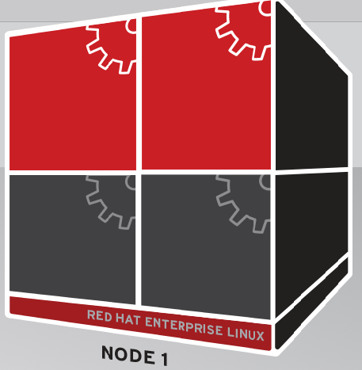
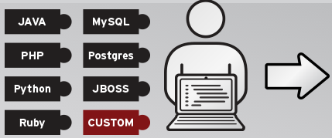
Workflow Of Openshift
2.Configure gear:-When you create your application, you also select from your choice of programming language, database, or other services via OpenShift cartridges. This can include your own favorite technologies via the custom cartridge capability.

Slide 9
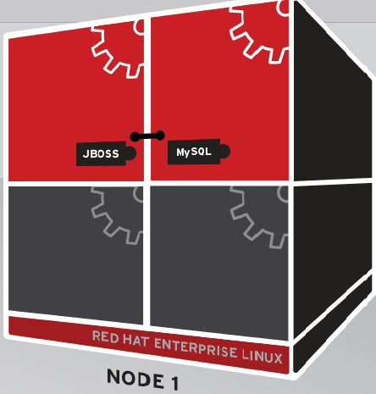
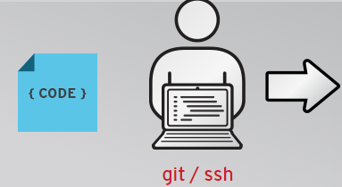
Workflow Of Openshift
3.Code and push:-OpenShift uses git for managing code inside of the platform. Simply perform a "git push" to deploy your code to your application.

Slide 10
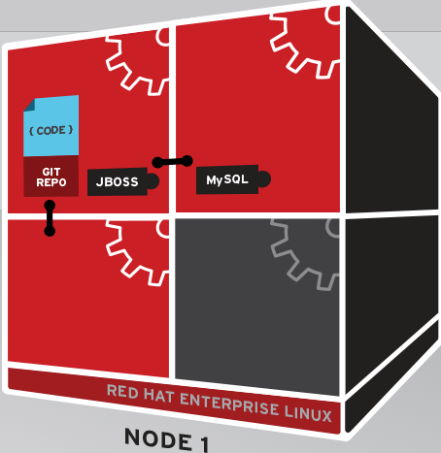
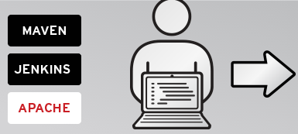
Workflow Of Openshift
4.Build, test, publish Automatically:-OpenShift automates the process with other tools such as Maven (Java builds), Jenkins (CI), and Apache (HTTP).

Slide 11
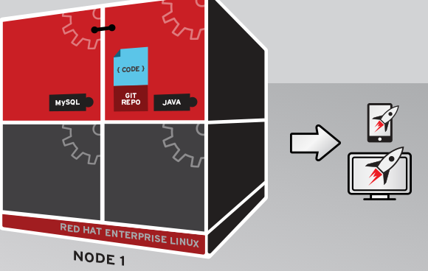

Workflow Of Openshift
5.OpenShift automates application scaling:-Using an HA-Proxy software load-balancer, OpenShift will horizontally scale the application with increasing load.
Before Scaling

Slide 12
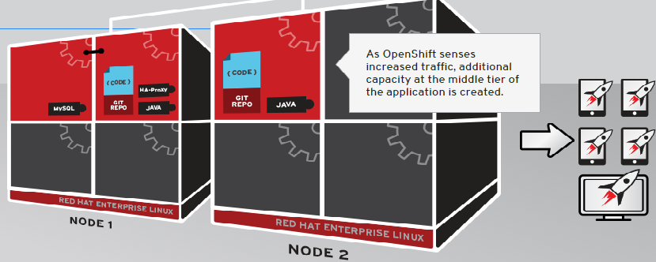
Workflow Of Openshift
6. After Scaling:- When enabled for scaling, Openshift inserts an HA-Proxy in front of the application to monitor traffic.

Slide 13
Overview Of Openshift
ONLINE Public PaaS
Host your applications in the public cloud. OpenShift Online automates the provisioning, management and scaling of applications so that you can focus on development and creativity.
ENTERPRISE Private PaaS
Accelerate your IT service delivery and streamline application development by leveraging PaaS in your own datacenters or private cloud.
ORIGIN Community PaaS
Explore the community-driven open source upstream of OpenShift. Download the bits, join the growing community, and help extend the functionality of OpenShift.

Slide 14
Difference between Openshift Online and Enterprise
Openshift Online | Openshift Enterprise
OpenShift Online is Red Hat’s hosted public PaaS that offers an application development, build, deployment, and hosting solution in the cloud. | OpenShift Enterprise takes the same open source PaaS platform that powers the OpenShift Online hosted service and packages it for customers who want an on-premise or private cloud deployment.
Lets applications scale automatically in an elastic cloud environment. | A private PaaS that you control and manage within the constraints of your enterprise standards.

Slide 15
Own Cartridges
While performing static code analysis using jenkins cartridge, we need SONAR.
But this kind of cartridge is not available(SONAR) in openshift platform list. So there is a need to create our own cartridge.
This can be done by downloading the manifest file of that new cartridge from github or by creating our own manifest file of that cartridge.

Slide 16
Usecase on Openshift Online

Slide 17
Creation Of Openshift Application in RHEL using command line tool
Install Ruby Gem and dependencies
OpenShift client tools is available as an RPM from the OpenShift hosted YUM repository.
To add the OpenShift YUM repository, download the repository file openshift.repo and move it to your /etc/yum.repos.d/ directory.
sudo mv ~/openshift.repo /etc/yum.repos.d/
In order to install the rubygems package the RHEL Optional channel must be enabled. This package is a dependency of OpenShift client tools. There are two ways of doing this from the command line:
sudo yum-config-manager --enable rhel-6-server-optional-rpms
(Certificate Based RHN tooling)
sudo rhn-channel --add --channel=rhel-x86_64-server-optional-6
(RHN Classic)

Slide 18
Creation Of Openshift Application in RHEL using command line tool
With the repository in place, you can now install the OpenShift client tools. Run:
sudo yum install rhc
Install Git
Download and install the latest version of git and set git identity
git config --global user.name "John Doe"
git config --global user.email johndoe@example.com
RHC setup process
Now run the RHC setup process:
rhc setup
The OpenShift interactive setup wizard displays and prompts you to complete the rest of the process.

Slide 19
Creation Of Openshift Application in RHEL using command line tool
To view the application cartridge types that are available:
rhc cartridges
Create a jenkins application
rhc app create --app jenkinsapp --type jenkins
Make a note of the user username and password that was created for you by
OpenShift.
Jenkins created successfully.
Please make note of these credentials
User: admin
Password: xxxxx
Log into the Jenkins web console:
http://jenkinsapp-yourAccountDomain.rhcloud.com

Slide 20
Creation Of Openshift Application in RHEL using command line tool
What Happens in actually in the creation of application??
OpenShift created a new application.
A new gear was created based on the Jenkins cartridge.
The gear was deployed to a Node in the OpenShift environment.
A DNS entry was created for this application.
A Git repo was created remotely and cloned to your local computer.
If you make changes to your code then the following operations should be done.
git commit -am "testing update“
git push

Slide 21
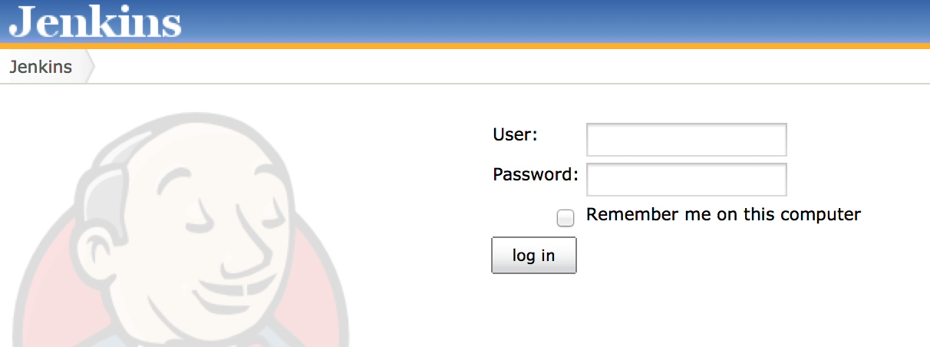
Creation Of Openshift Application in RHEL using command line tool

Slide 22
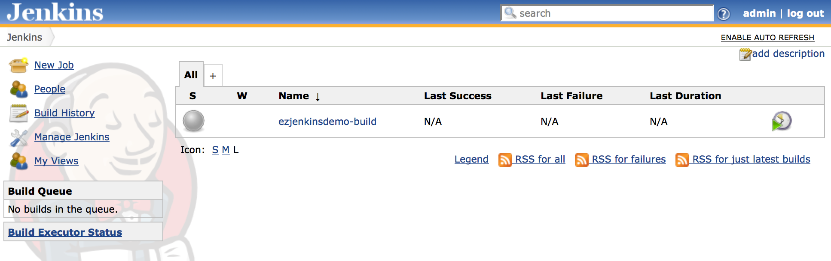
Creation Of Openshift Application in RHEL using command line tool

Slide 23
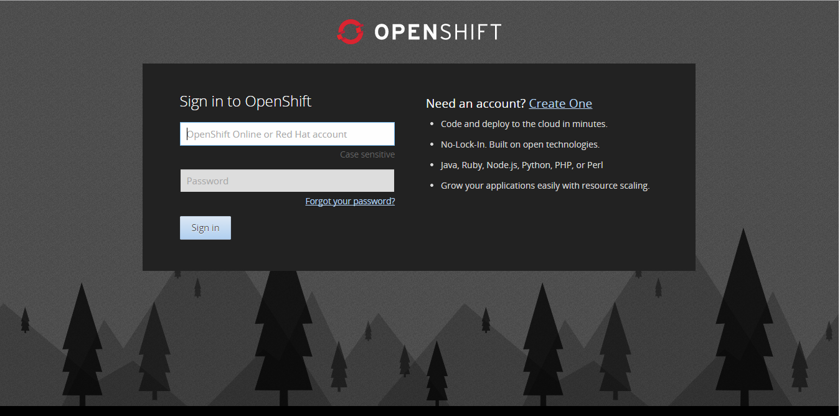
Creation Of Openshift Application in RHEL using Console
Create an account in Redhat Openshift on the following site.
https://openshift.redhat.com/app/console/applications

Slide 24
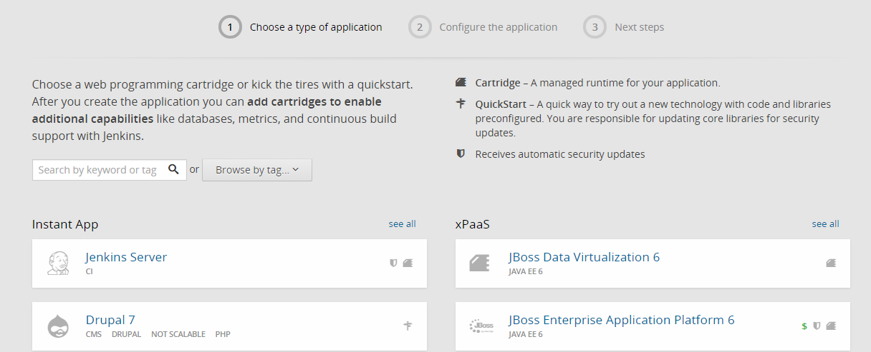
Creation Of Openshift Application in RHEL using Console
Create your first application Now by choosing a web framework or codebase to start from.
Choose the type of Application → Add cartridges

Slide 25
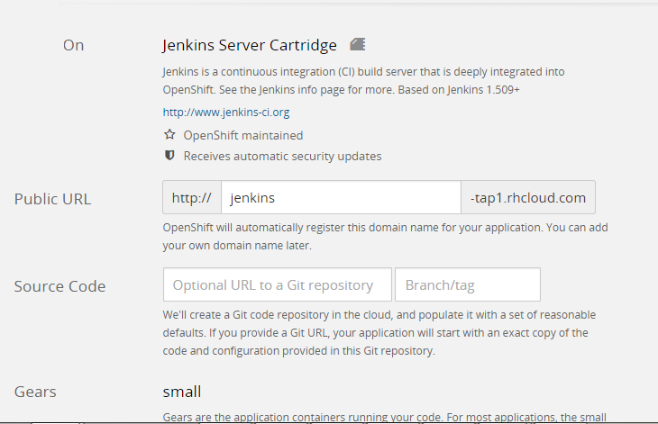
Creation Of Openshift Application in RHEL using Console
Configure your application
Give the public Url

Slide 26
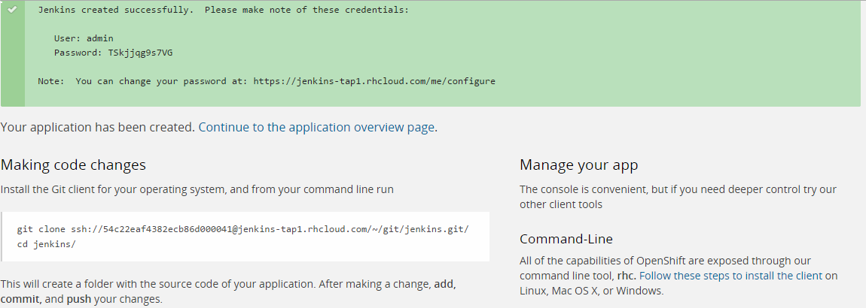
Creation Of Openshift Application in RHEL using Console
Now the application has been created successfully and git repository has been created where you can push your code. The username and password for jenkins server is also mentioned

Slide 27
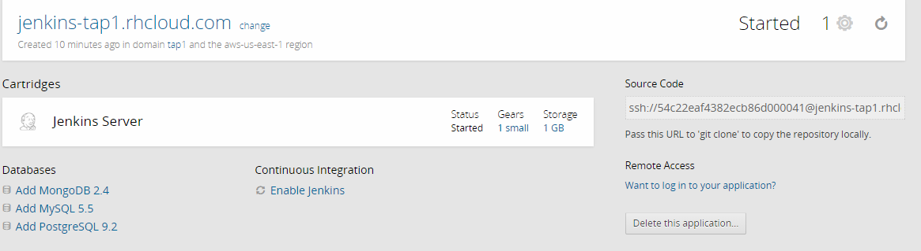
Creation Of Openshift Application in RHEL using Console
Here we have the URL jenkins-tap1.rhcloud.com where you can view the jenkins server and create jobs there using credentials provided in previous step.

Slide 28
Thank you
Visit us at www.techmahindra.com
28

